Slide 1
Survey Comparison Project Figures

Slide 2
SVC vs. Roving Surveys

Slide 3
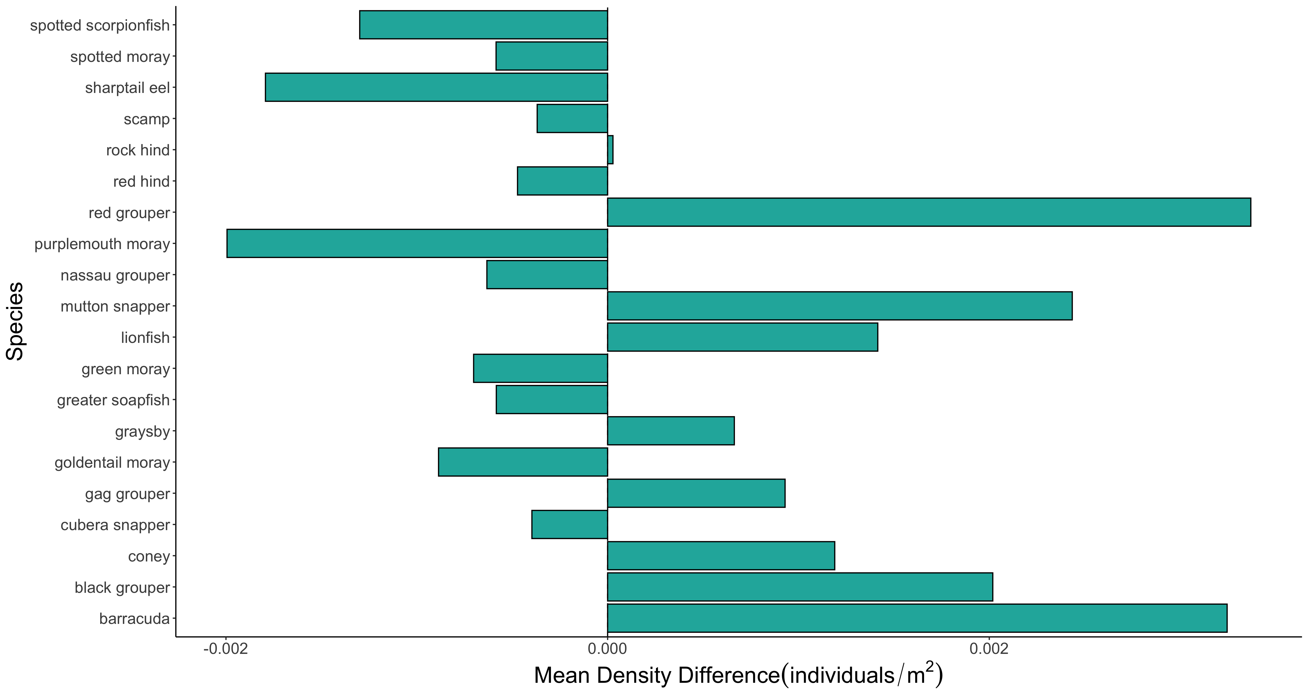

Slide 4
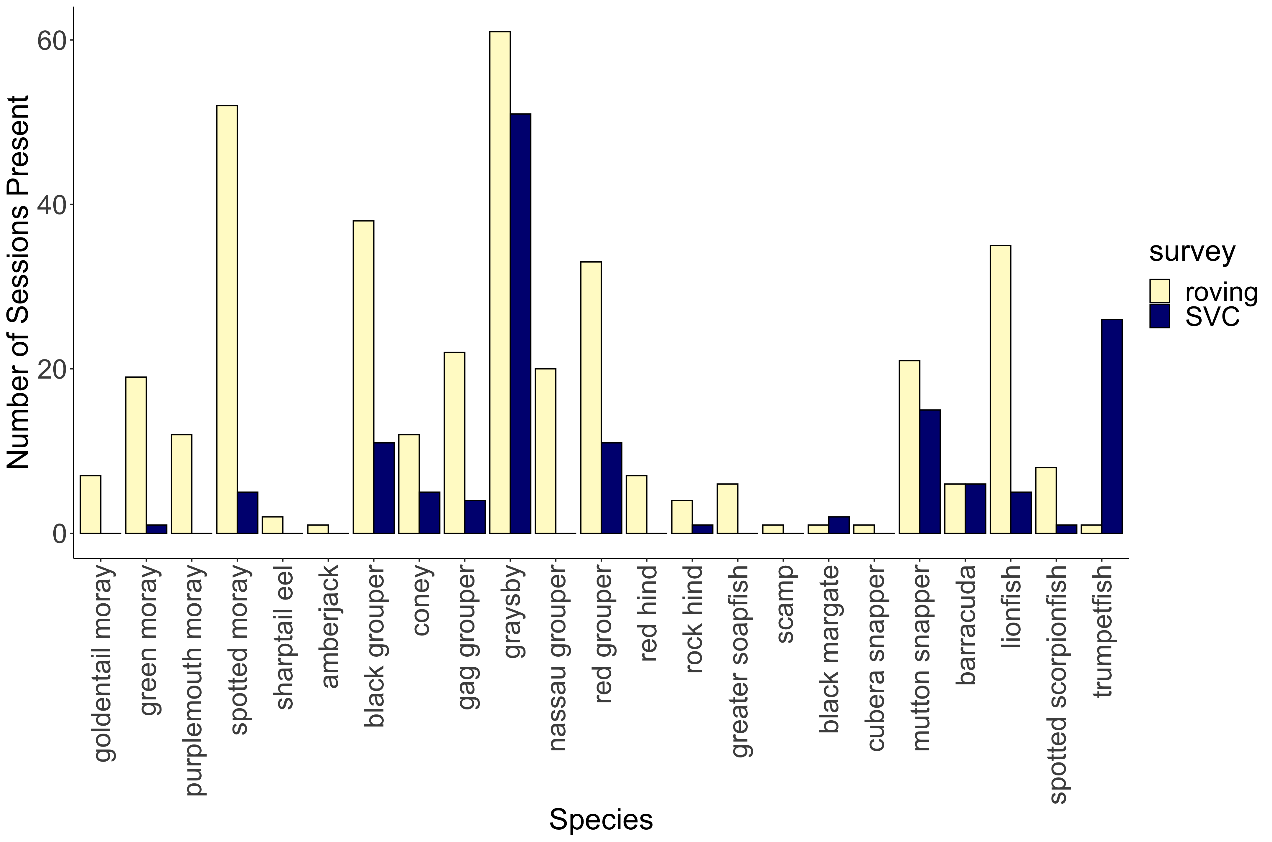
***
***
***
***
***
***
***
***
**
*
*
*
*

Slide 5
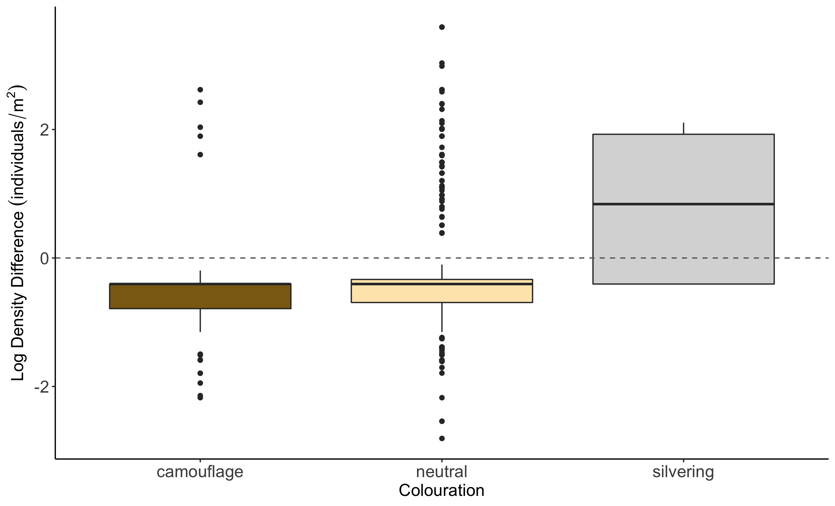
b
a
c

Slide 6
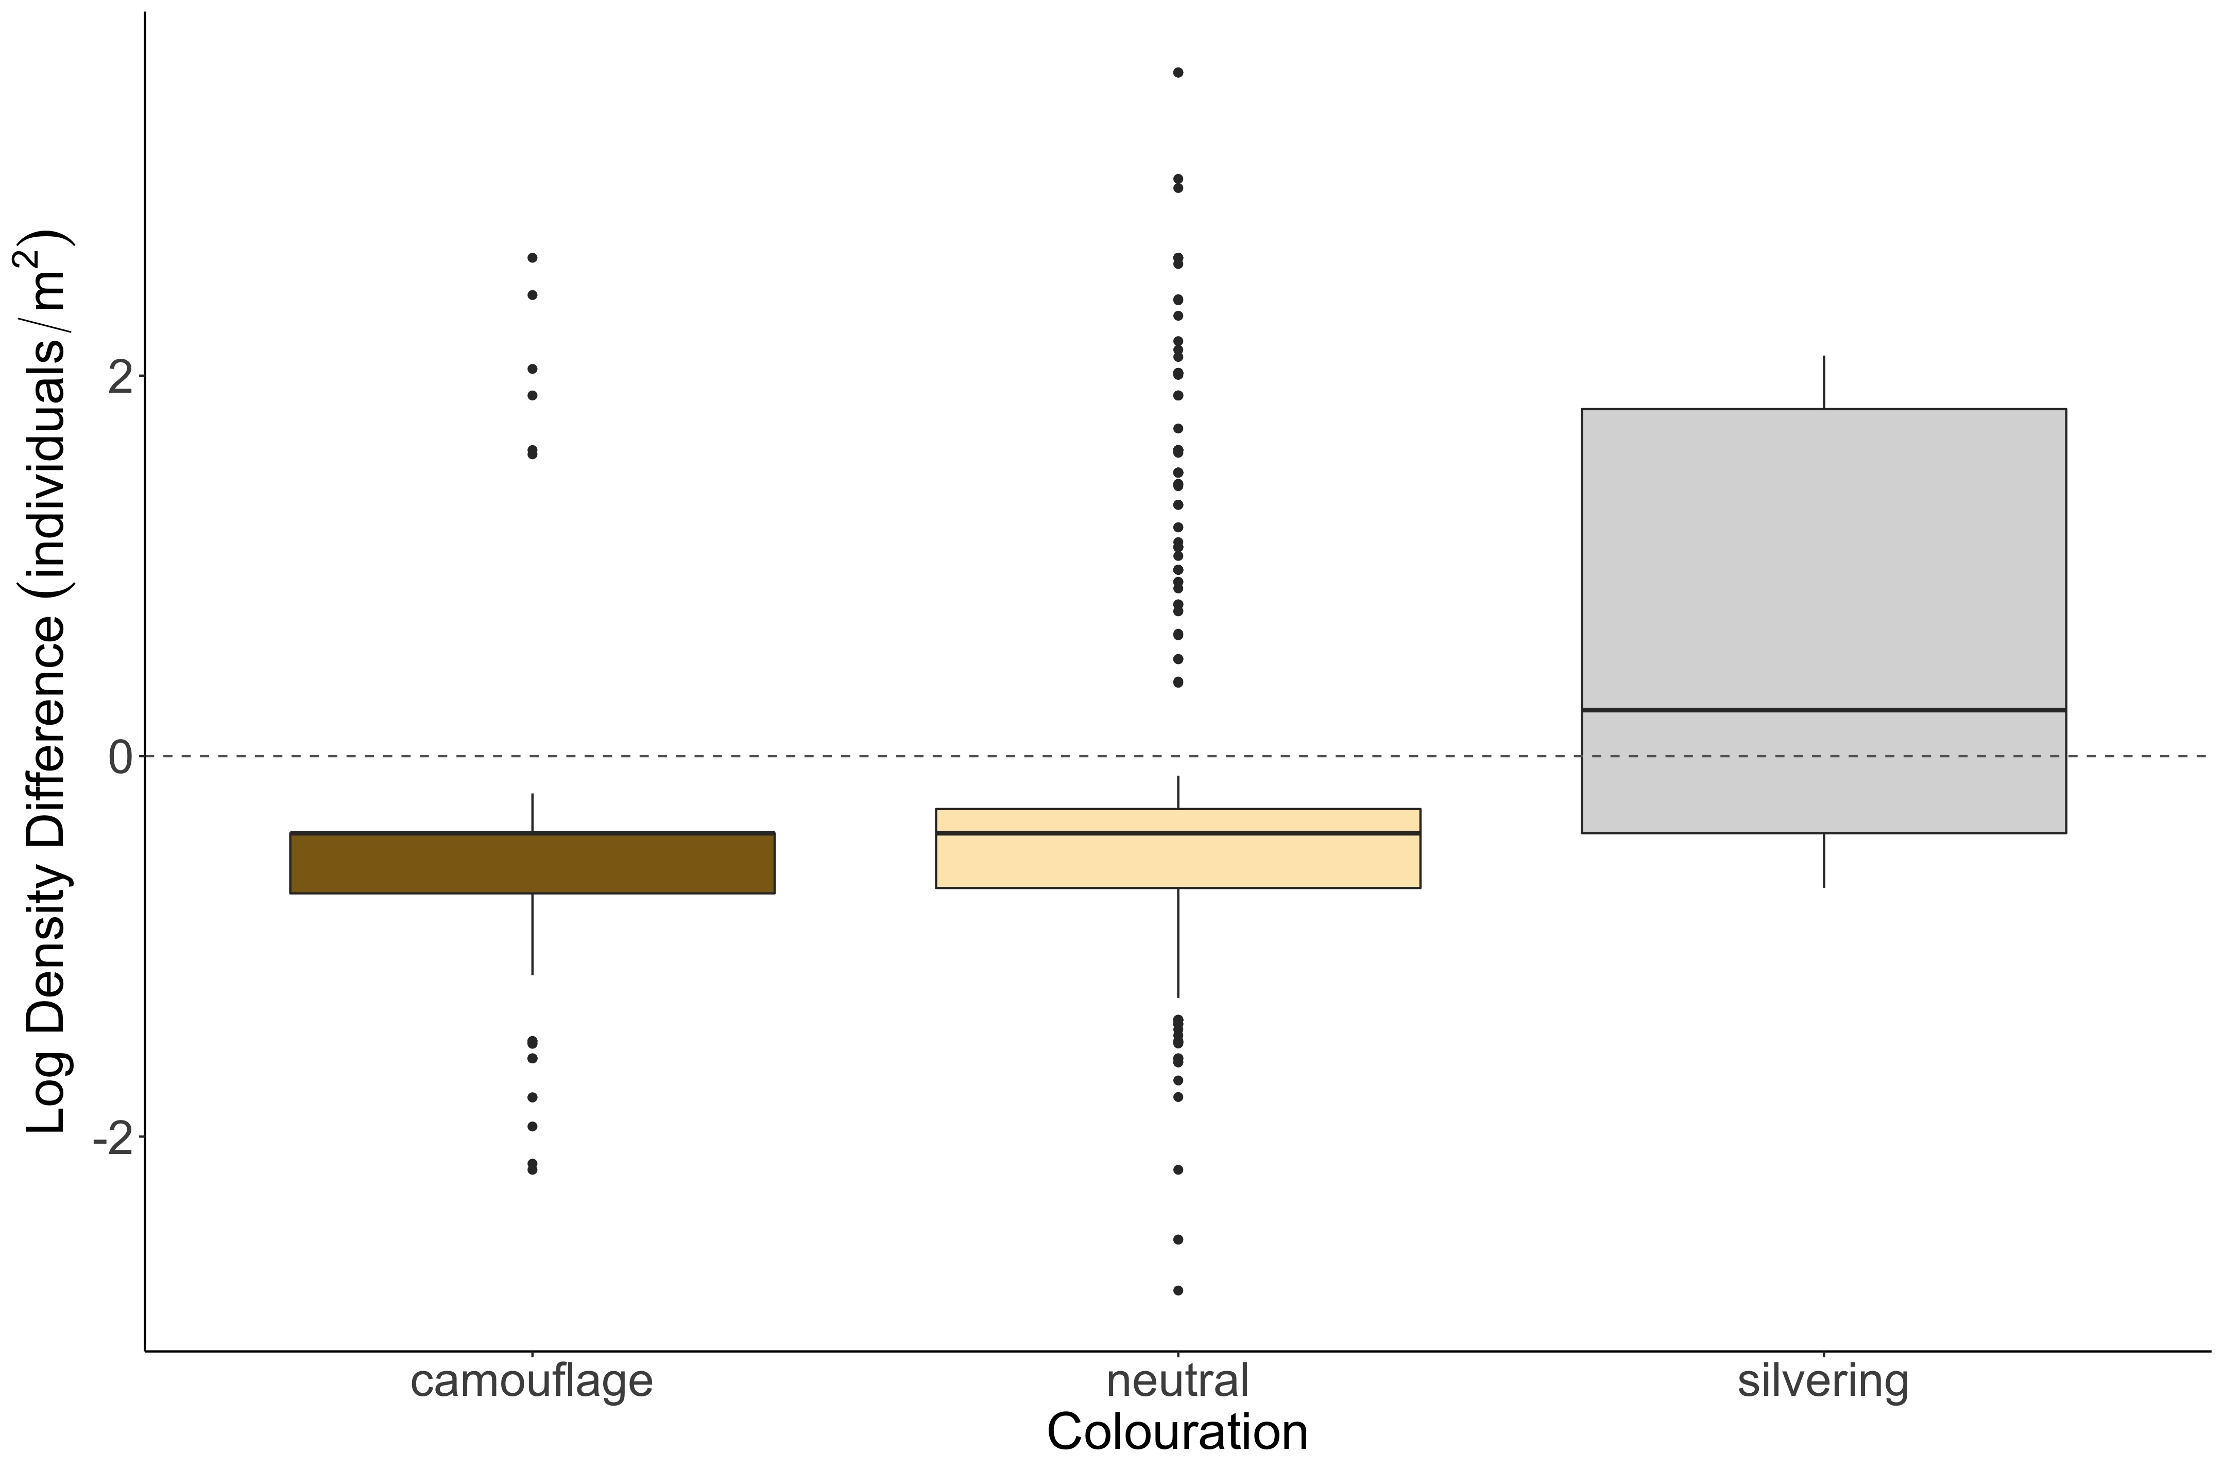
b
a
c

Slide 7
SVC vs. Transect Figures

Slide 8
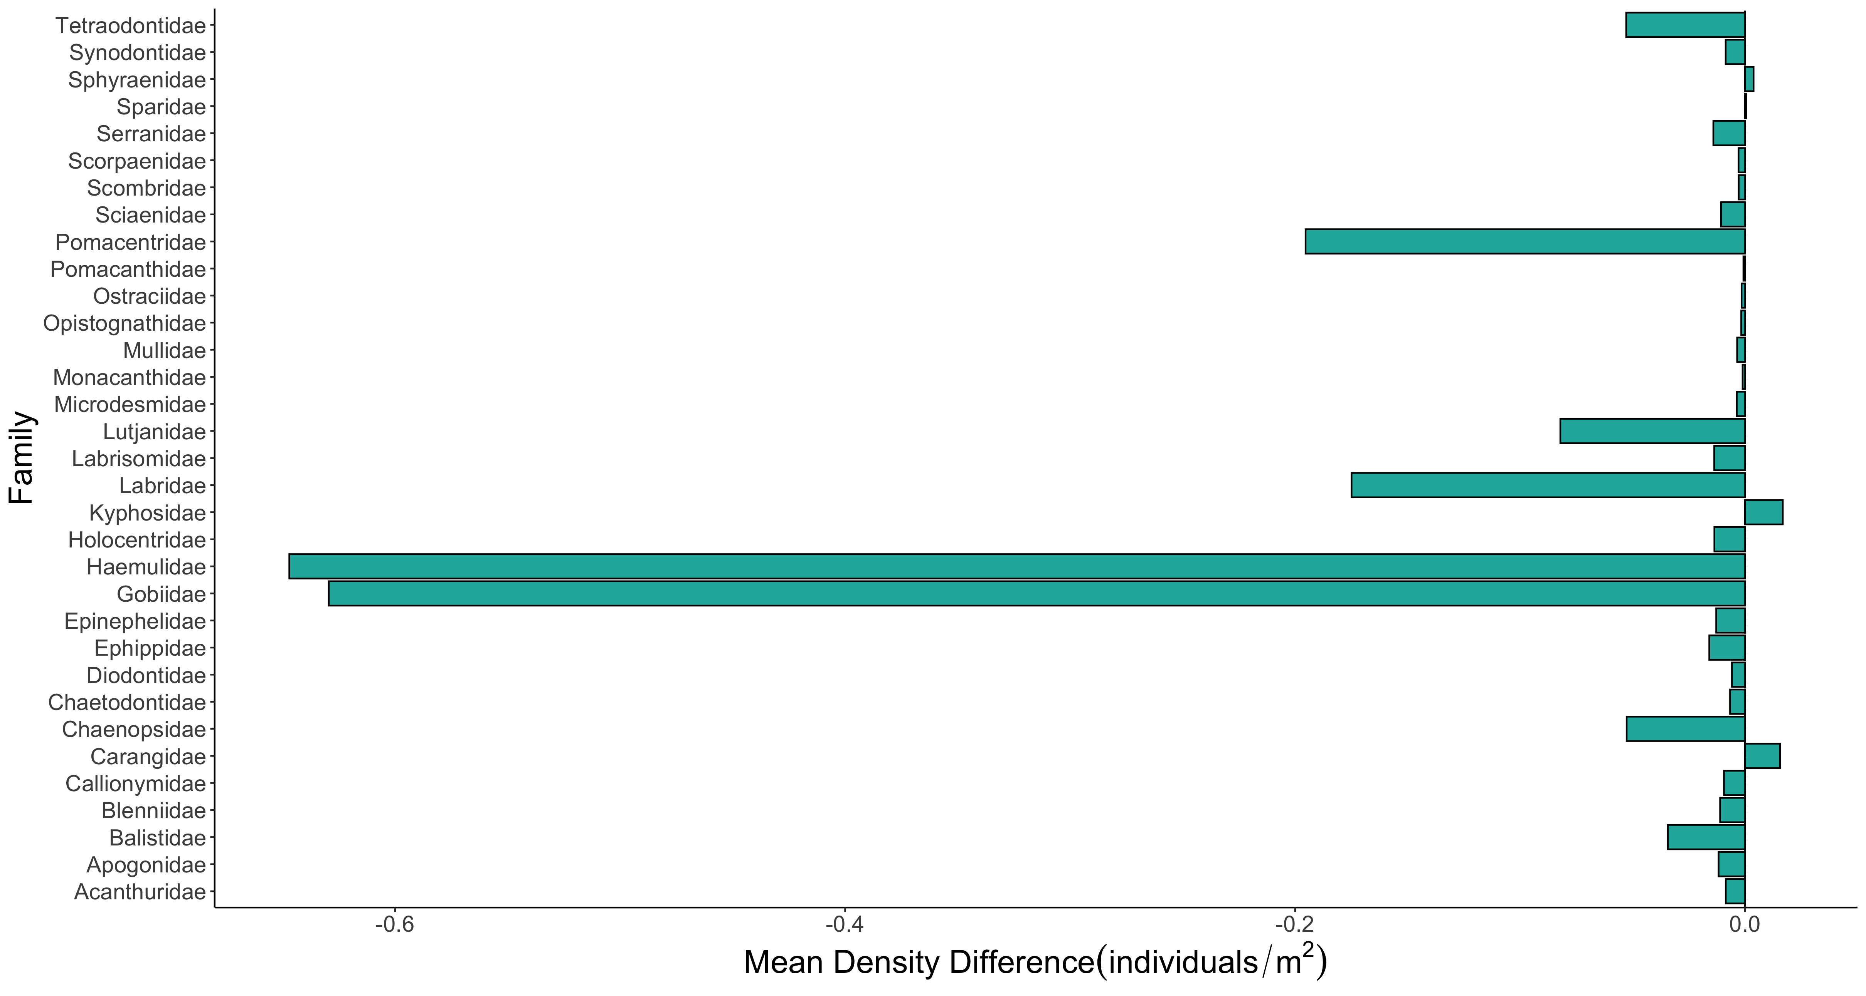

Slide 9
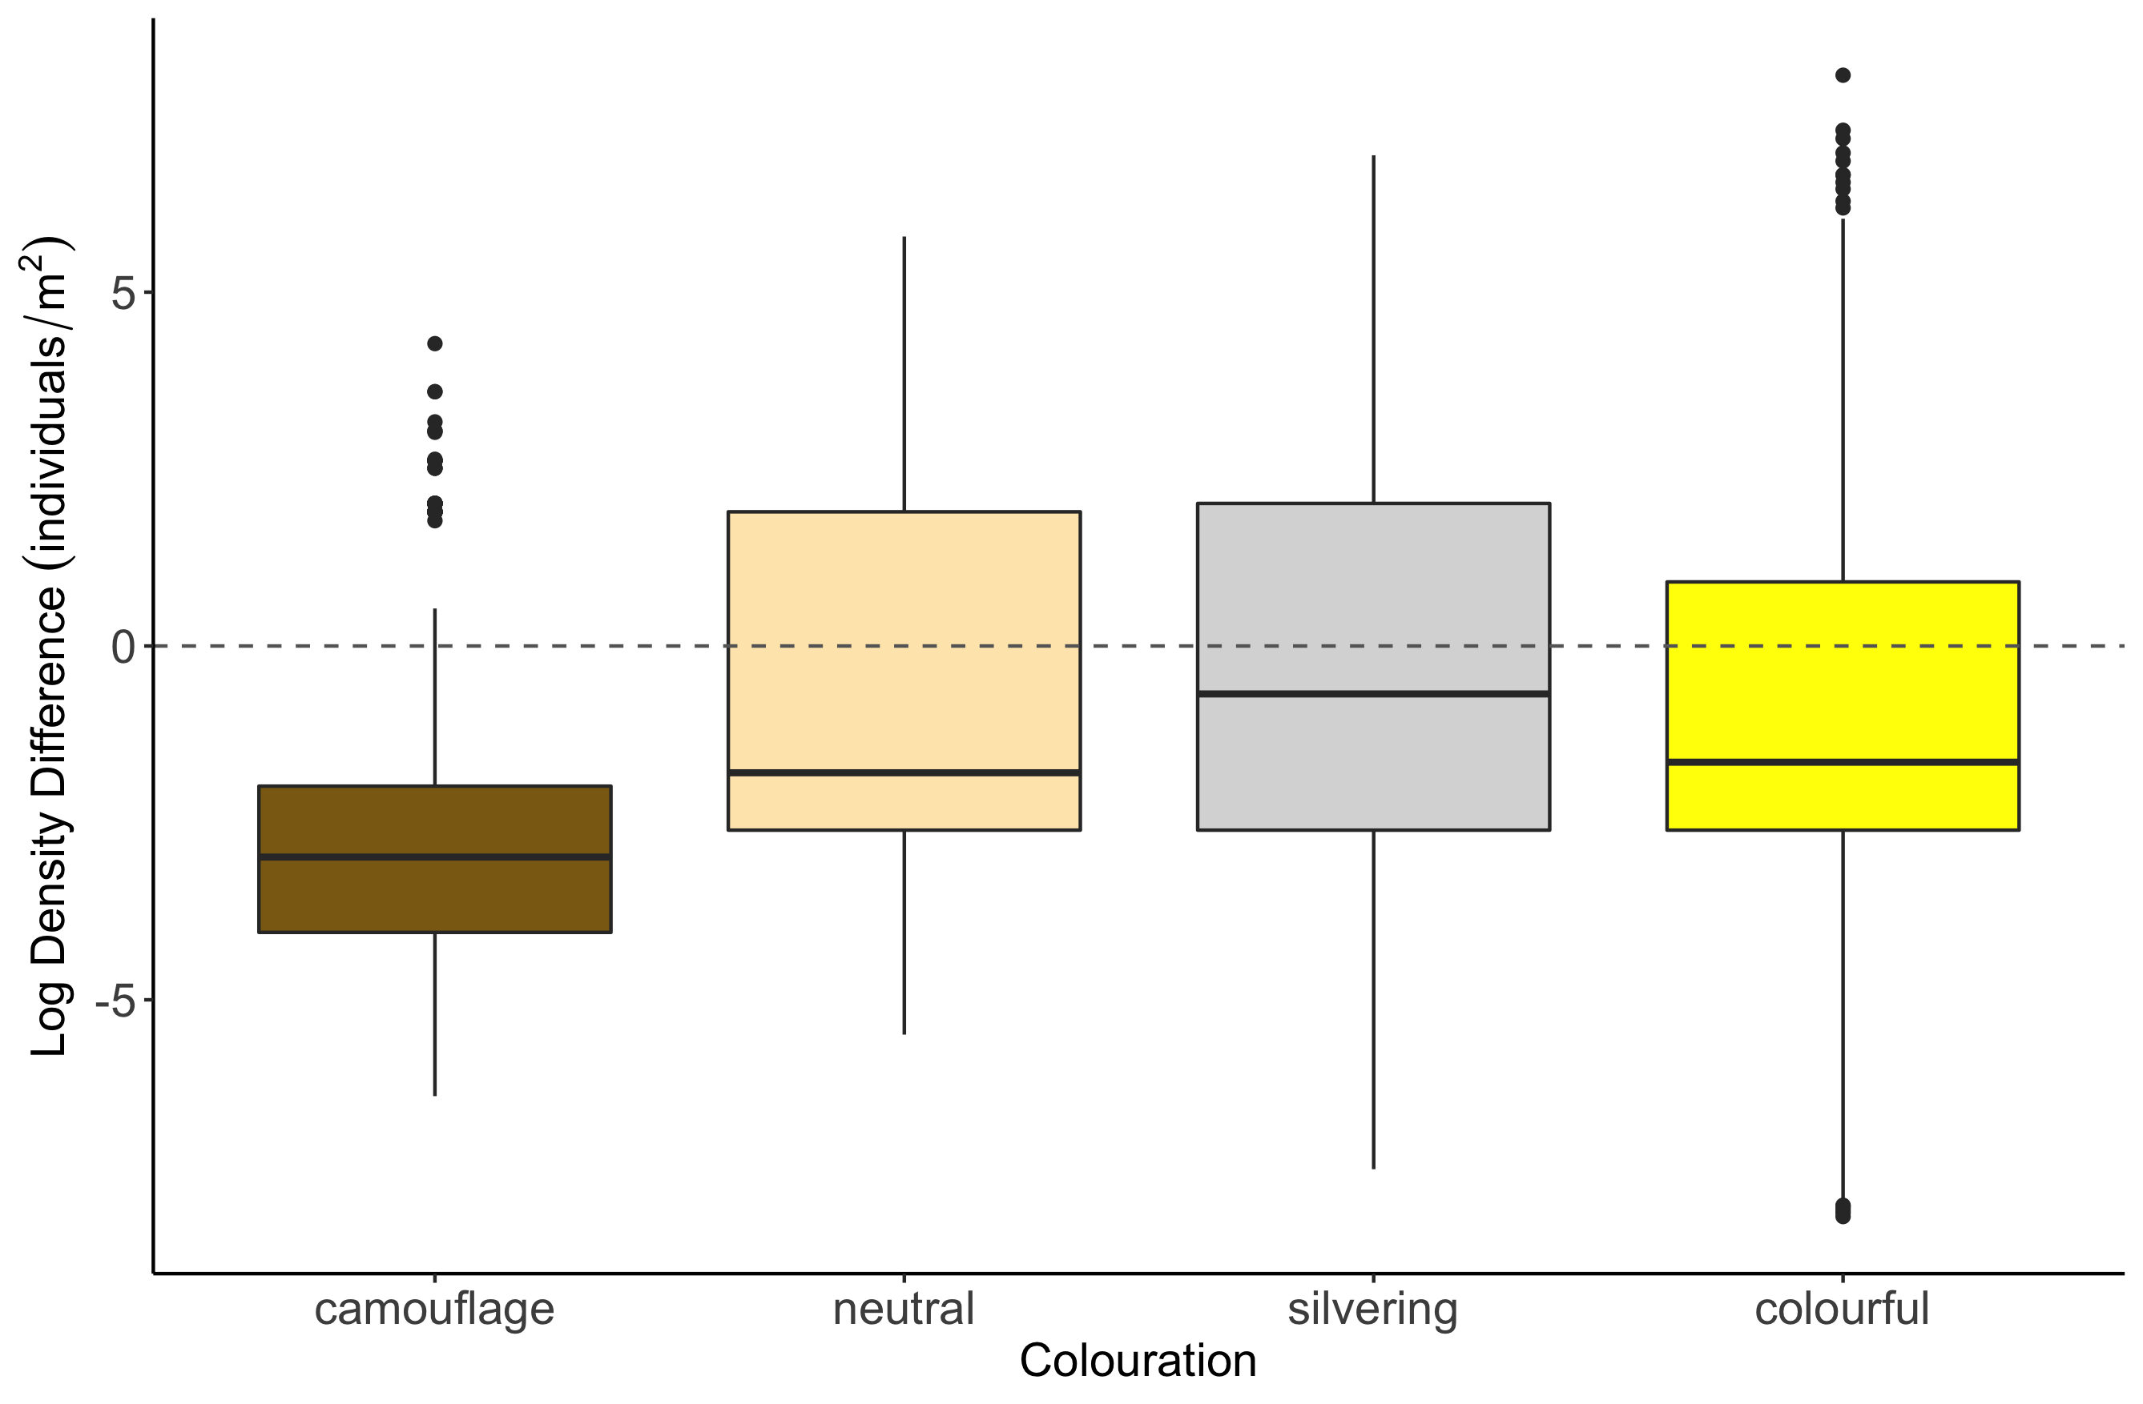
c
b
b
a

Slide 10
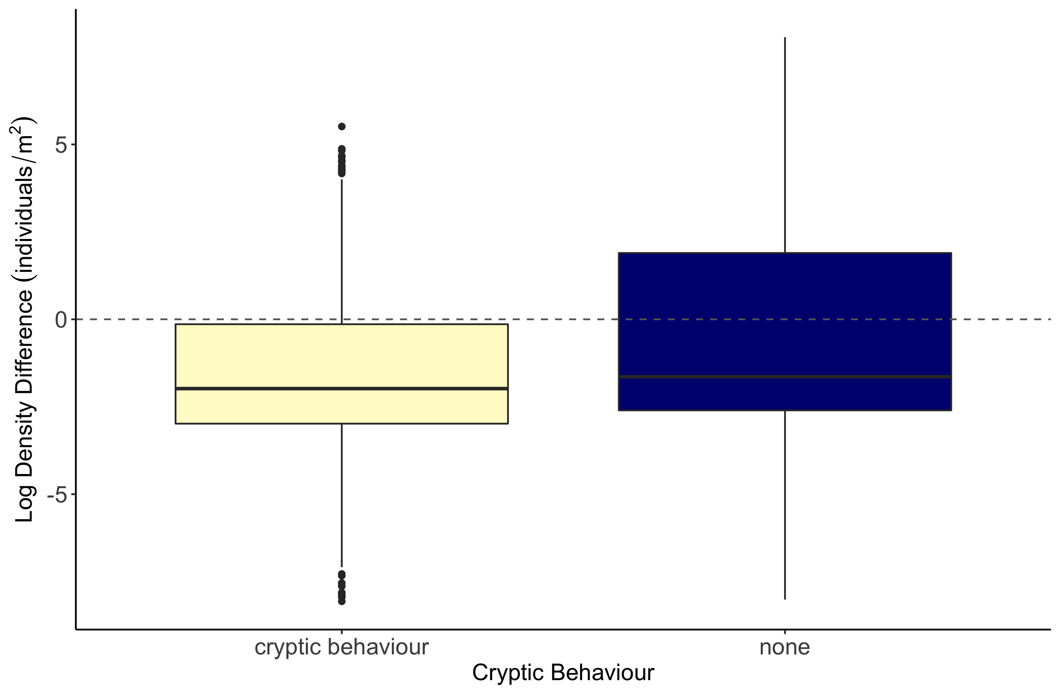
b
a

Slide 11
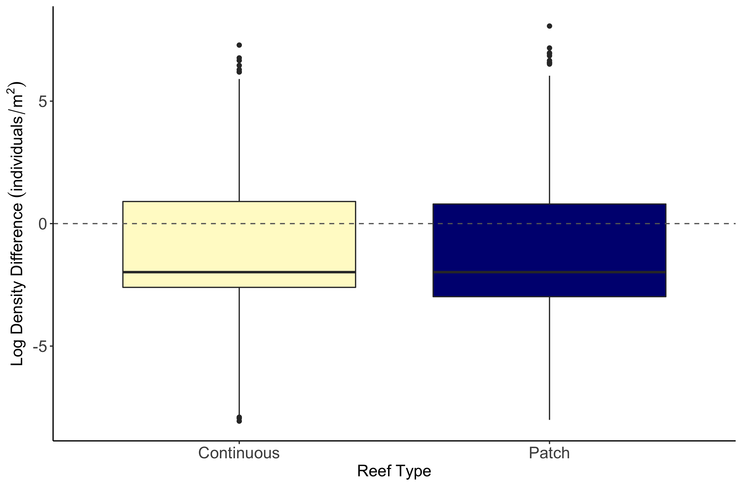
b
a

Slide 12
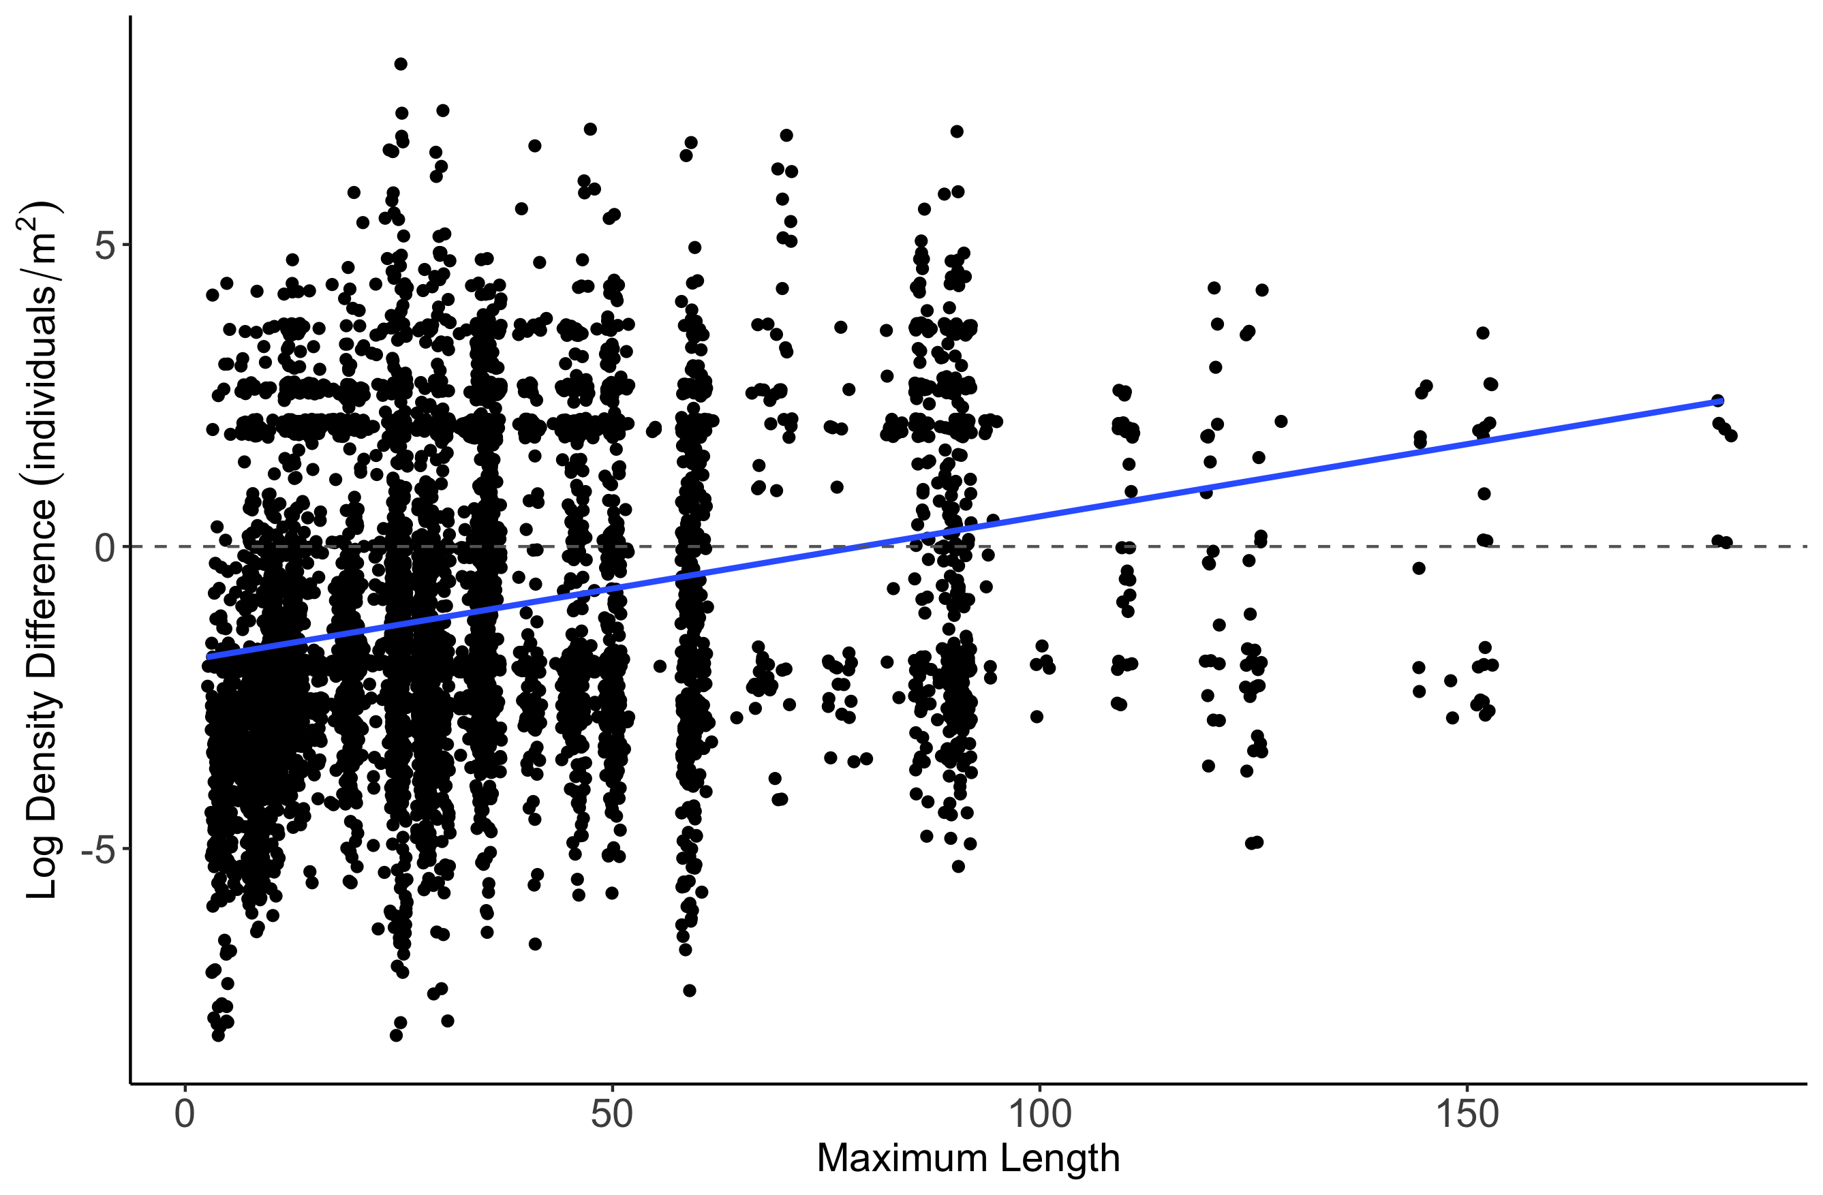
Estimate = 0.0077157
z value = 4.307
p-value = 1.65e-05

Slide 13
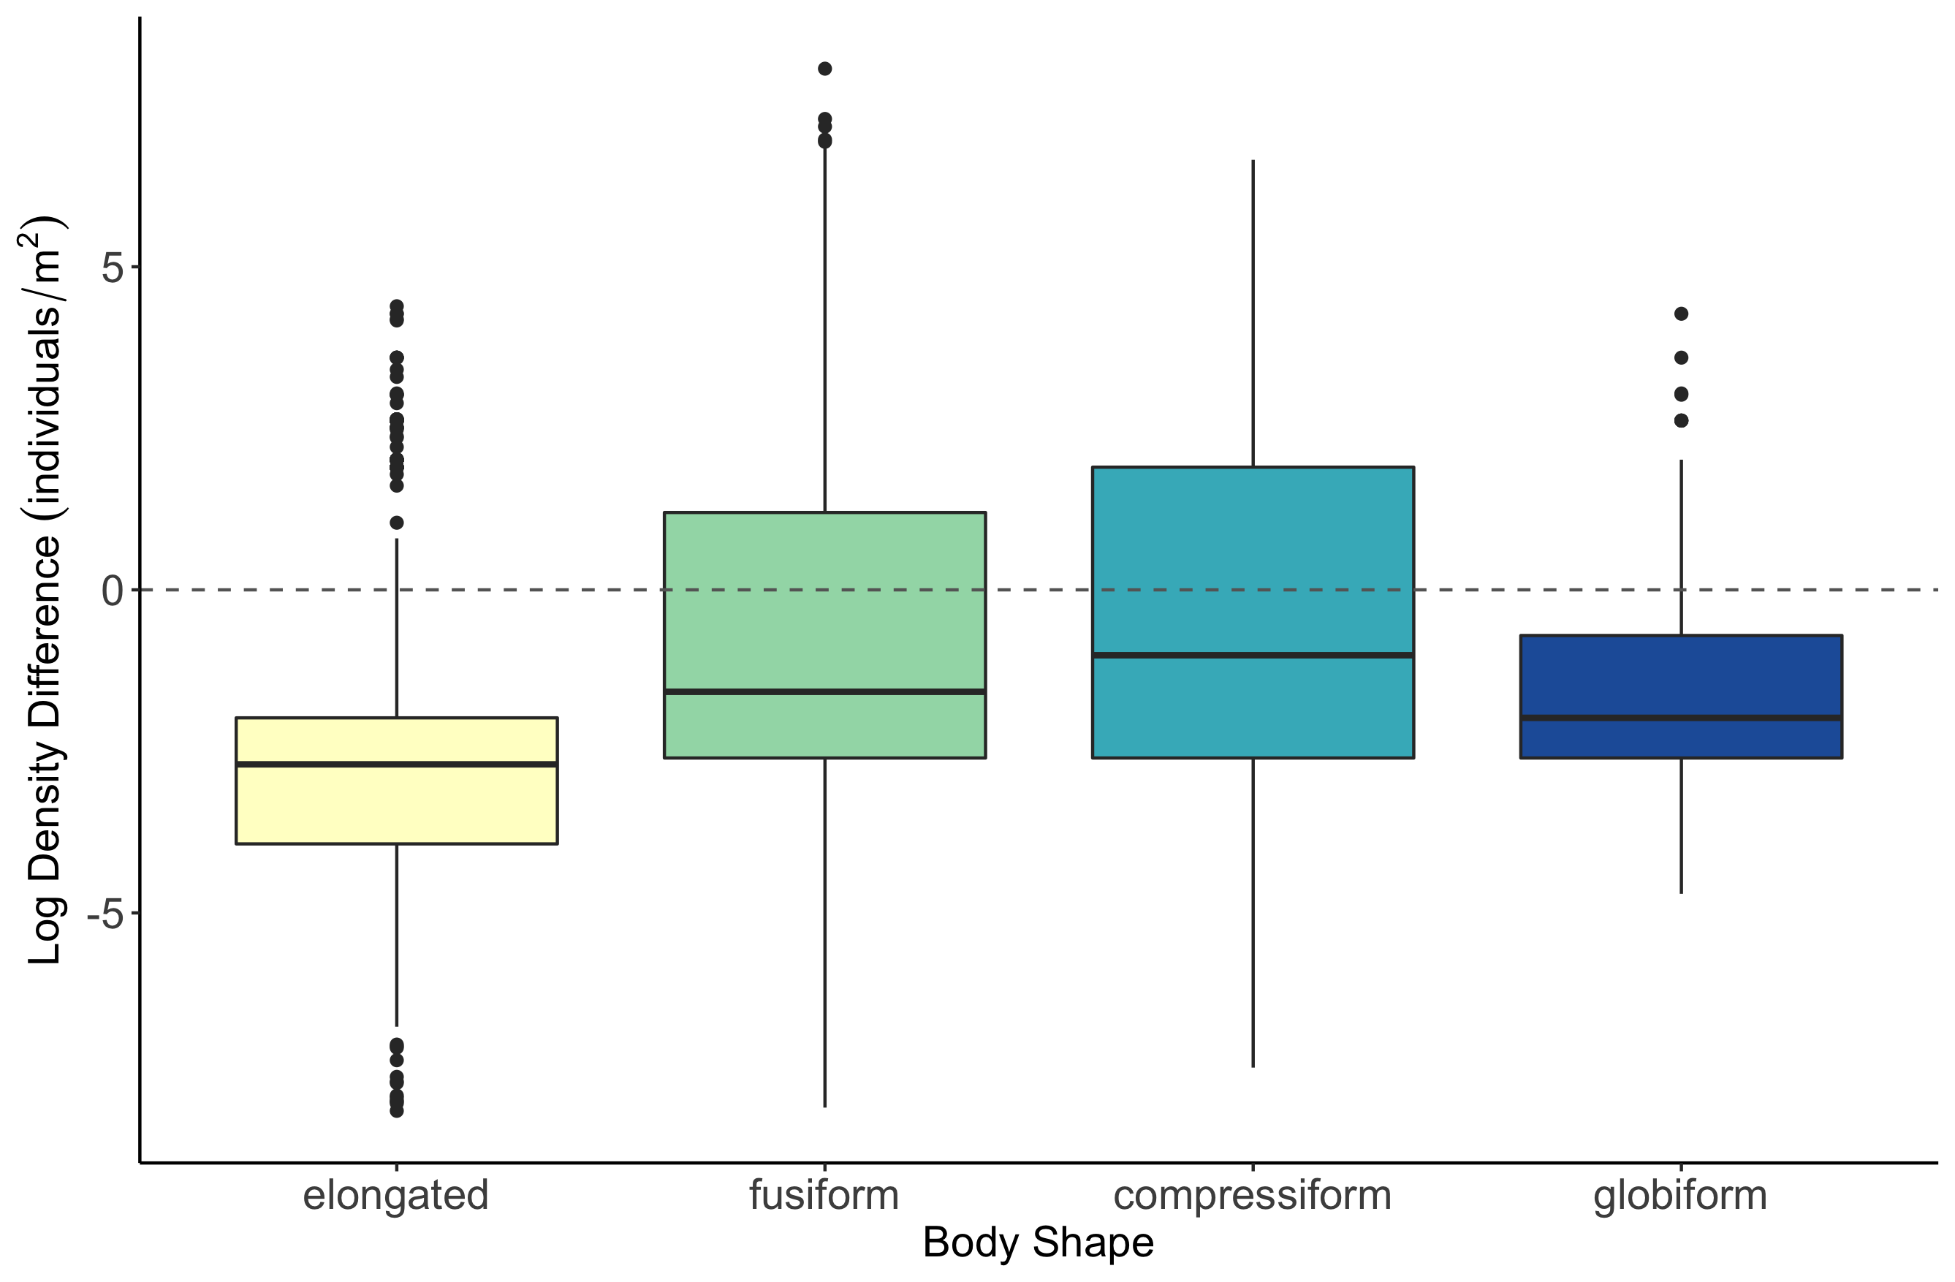
b
c
a
d

Slide 14
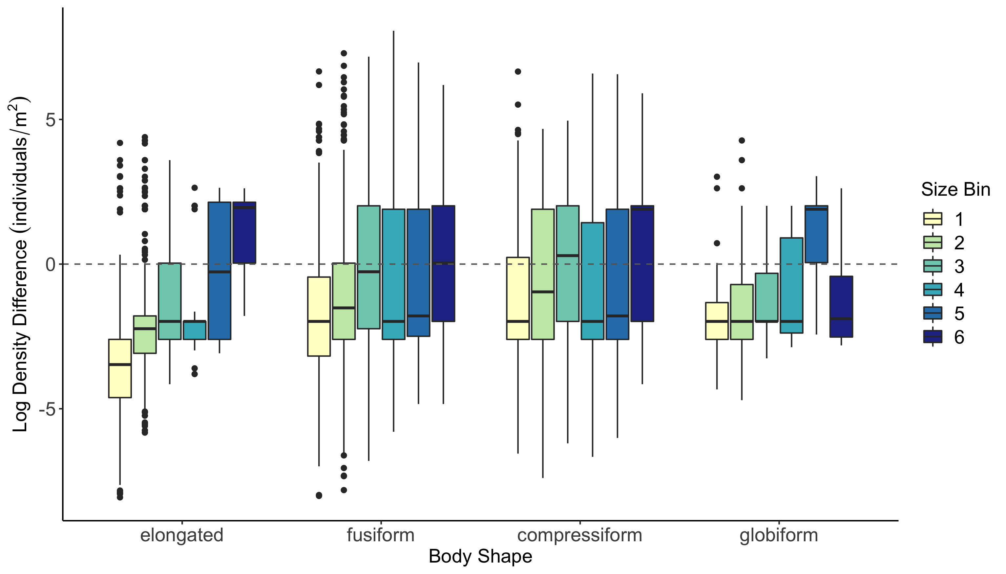

Slide 15
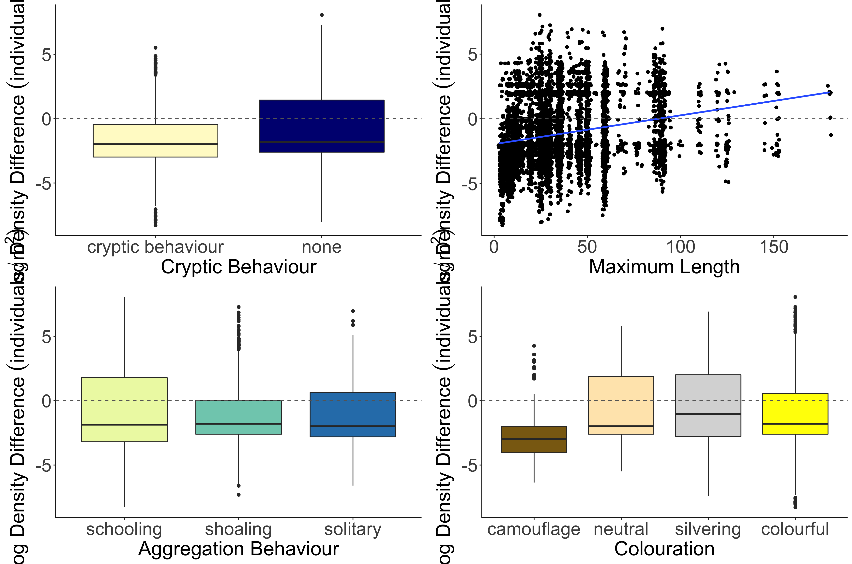
b
Estimate = 0.006355
z value = 3.801
p-value = 0.000144
a
Log Density Difference (individuals/m²)
c
b
b
a

Slide 16
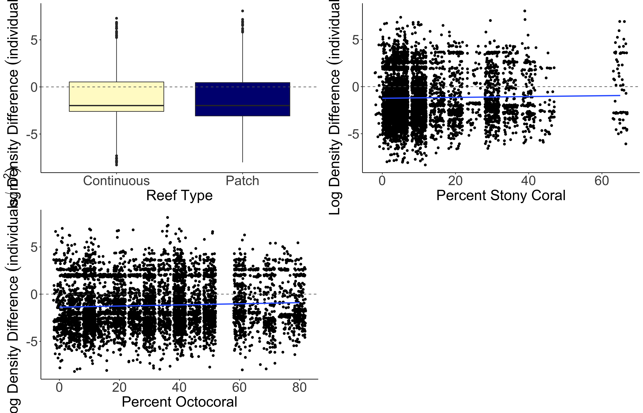
a
b
Estimate = 0.015630
z value = 4.570
p-value = 4.9e-06
Log Density Difference (individuals/m²)
Estimate = 0.009786
z value = 6.254
p-value = < 2e-16

Slide 17
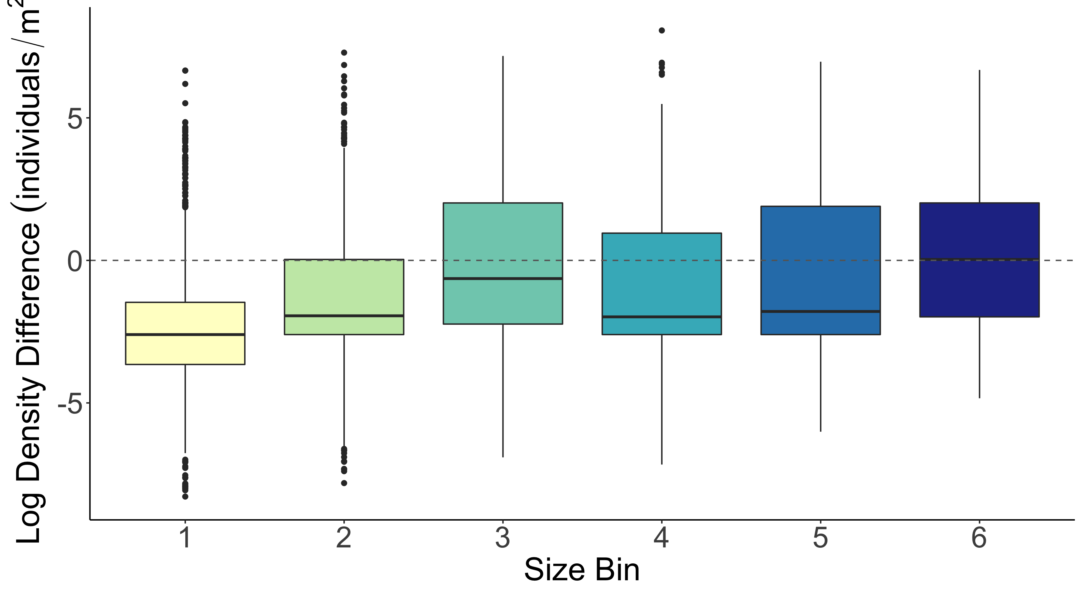
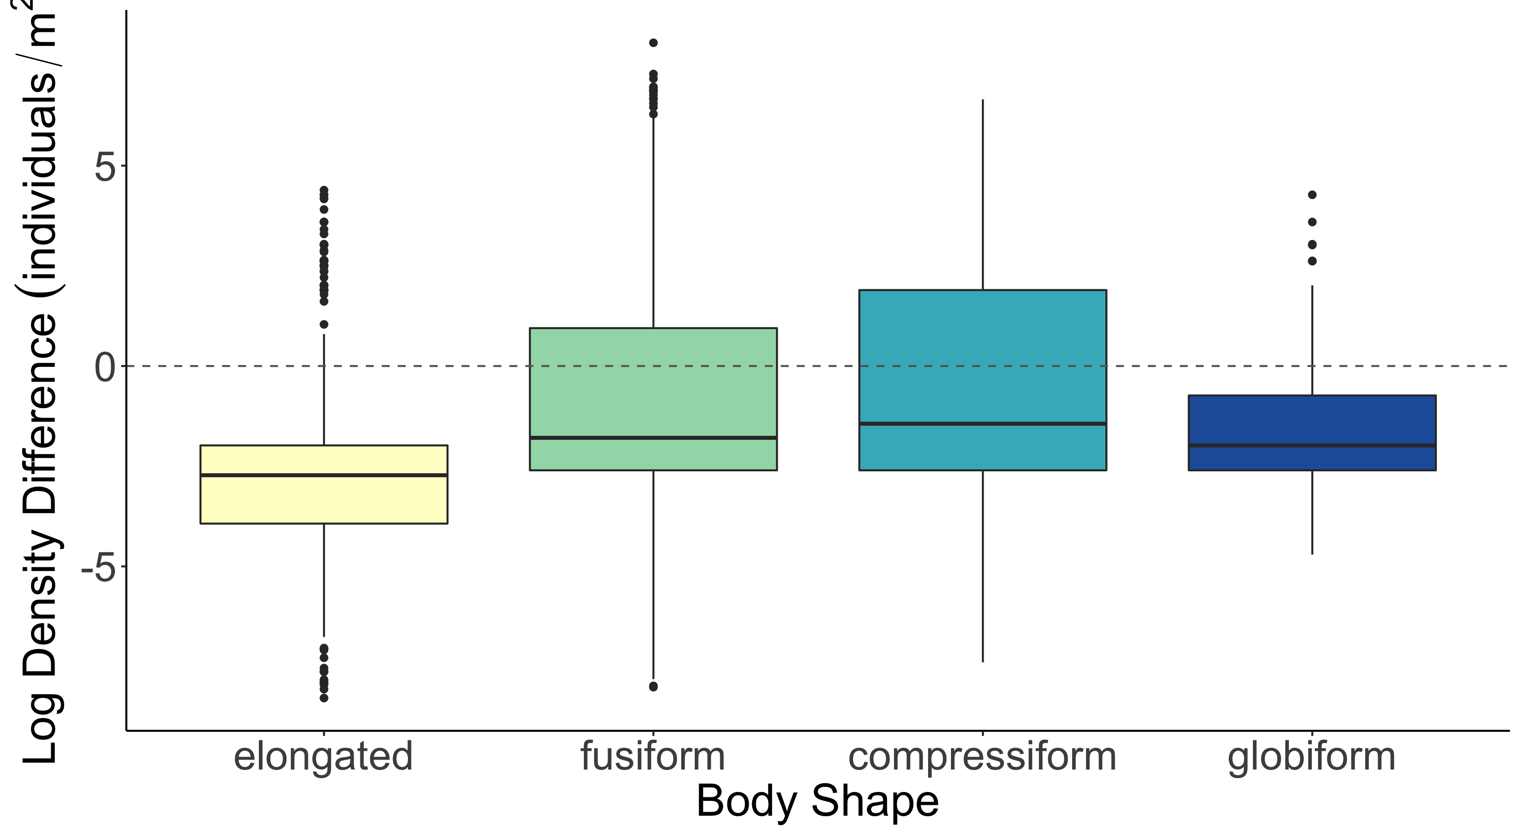
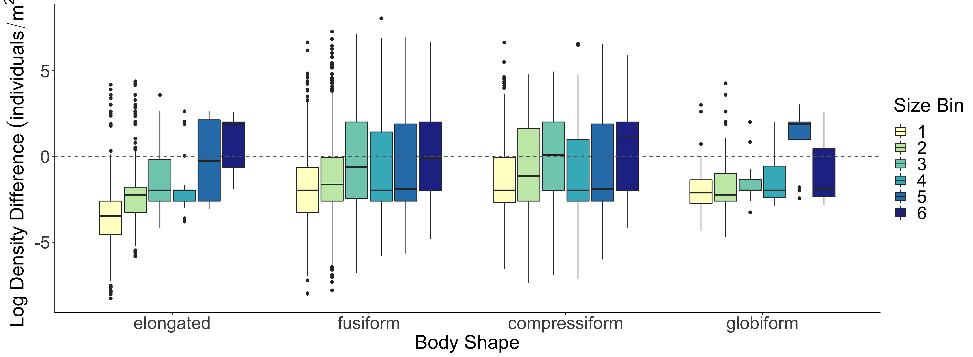
b
b
b
a
c
d
c
c
a
d
b
c
Log Density Difference (individuals/m²)
a
d

